Slide 1
Scientific Methodology

Slide 2
SCIENTIFIC METHODS:
What procedures are at the core of scientific methodology?
Observing and Answering Questions
Making Inferences and Forming Hypothesis
Conducting Controlled Experiments
Collecting and Analyzing data
Drawing Conclusions

Slide 3
Observations:
An observation is the act of gathering information.
Types of observations
Qualitative data
Quantitative data

Slide 4
Types of Observations:
Qualitative data describes:
Color
Odor
Shape
Some other physical characteristic

Slide 5
Types of Observations:
Quantitative data
Numerical information such as:
Temperature
Pressure
Volume
Quantity (how many or how much)

Slide 6
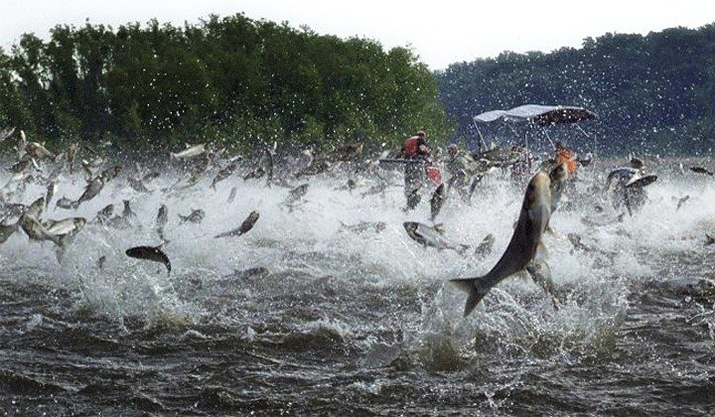
What types of data can we observe from this photo?

Slide 7
Hypothesis
A hypothesis is a tentative explanation of what has been observed.
Example: If I use fertilizer on my plants, they will grow faster than if I don’t use fertilizer
However, a hypothesis means nothing unless there is data to support it.

Slide 8
Null Hypothesis
Null Hypothesis – a hypothesis that you are trying to disprove.
Example: If I use fertilizer on my plants they will not grow faster.

Slide 9
Experiment
An experiment is a set of controlled observations that test the hypothesis.
An experiment must change or test one variable at a time.

Slide 10
Experimental Variables
Independent variable – variable that a scientist will change
Fertilizer
Dependent variable – variable that will be changed by the independent variable
How much the plants grow

Slide 11
Experimental Variables
Control – standard for comparison.
Plants that will not receive fertilizer, but will be treated the same in every other way (water, sunlight)
Constant – the part that does not change.
Water, sunlight, temperature, etc.

Slide 12
Collecting and Analyzing Data

Slide 13
Model
A model is a visual, verbal, and/or mathematical explanation of experimental data

Slide 14
If an experiment disproves the hypothesis, it can be revised and then tested again
Figure 1-4:
Revising Hypotheses

Slide 15
Conclusion
Conclusion: a judgement based on the information obtained by the experiment.
A hypothesis can never be proven, but it can be supported.
If the plants treated with fertilizer grow taller than the plants not treated with fertilizer. My experiment supported my hypothesis.

Slide 16
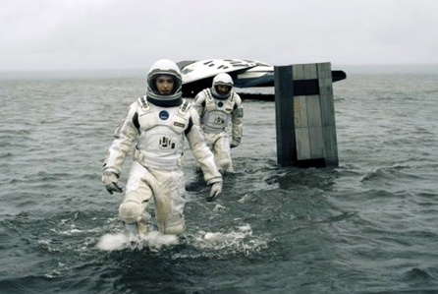
Theory
A theory is an explanation that
has been supported by many,
many experiments.
Einstein’s theory of relativity =
Interstellar
States a broad principle of nature that has been supported over time.
All theories are still subject new experimental data and can be modified.

Slide 17
Scientific Law
A scientific law is a relationship with nature that has been supported by many experiments and many scientists over an extended period of time
i.e.: Gravity

