Slide 1
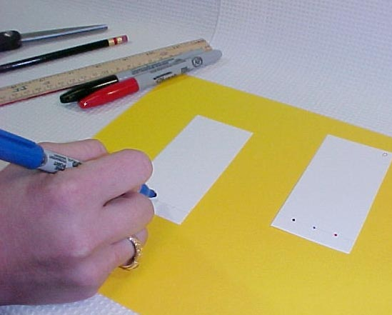

Slide 2
Paper Chromatography of a Spinach Leaf Lab
Paper chromatography is a process that uses filter paper to separate and identify the different substances in a mixture.
Chromatography means “to write with color.”
The substances in the mixture dissolve in rubbing alcohol and move up the paper.
The heavier substances move up the paper more slowly.
The lighter substances move up the paper more quickly.
So heavy and light substances get separated from one another on the paper.

Slide 3
Chlorophyll is the pigment that gives plants their green color.
Pigments are compounds that absorb light and plants have several kinds of pigments.
They all play an important role in increasing the leaf’s efficiency at capturing light energy for photosynthesis.
The more pigments available the more of the wavelengths of light will be used.

Slide 4
Chlorophyll a reflects dark green light
Chlorophyll b reflects light green light
Carotenes reflect orange light
Xanthophyll reflect yellow light
These various pigments are not always visible because the chlorophylls are present in such large amounts that the others are masked over. We will set out in this experiment to prove the presence of the accessory pigments.

Slide 5
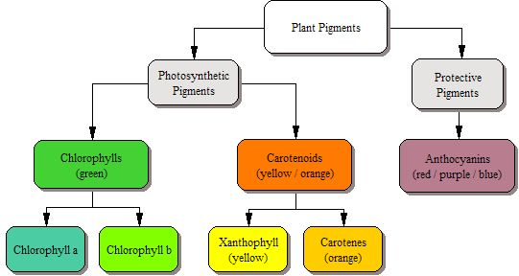

Slide 6
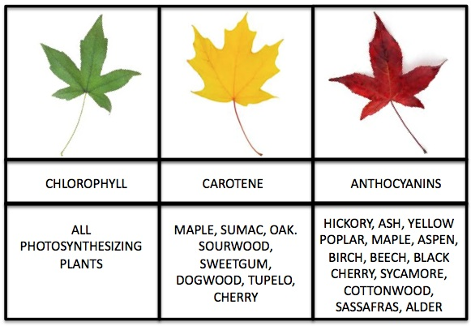

Slide 7
Changing Colors
As summer ends and autumn begins in the northern hemisphere, the days get shorter and shorter.
The decrease in sunlight is how trees "know" to begin getting ready for winter.
During winter, there is not enough light or water for photosynthesis. The trees will stop producing as much glucose; they live off the food stored during the summer.
The green chlorophyll breaks down in the leaves. As the bright green pigment fades away, yellow, red, and orange pigments become visible.
Small amounts of these colors have been in the leaves all along. We just can't see them in the summer, because they are hidden by the green chlorophyll.

Slide 8
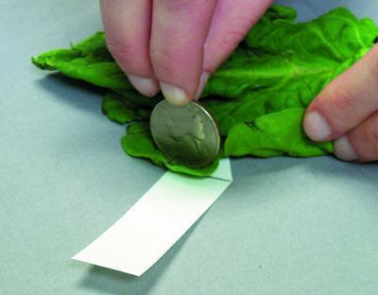
Purpose: To see if green spinach leaves also contain other pigments.
Hypothesis: What pigments do you think you will see in the spinach leaf? Write and record in on you paper
Materials:
Isopropyl alcohol
ruler
spinach leaf
chromatography paper
pencil
beaker
colored pencils
ruler

Slide 9
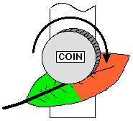
Procedure:
Obtain a strip of chromatography filter paper
Draw a pencil line 2 cm from the bottom of the filter paper (use a ruler)
Obtain a spinach leaf and a quarter
Place the spinach leaf over the pencil line and roll the edge of the quarter, this will result in a thin green line. Repeat this 10 times
Take a small piece of tape to tape the top of the filter paper to a pencil or pen and place the pencil/pen over the top of the beaker. The bottom of the paper should be just toughing the bottom of the beaker.
Let me know when this is complete and I will come around with isopropyl alcohol
4. Record observations in data table.

Slide 10
