Slide 1
Carbon Compounds
Chapter 2.3

Slide 2
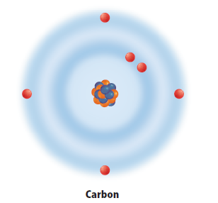
Organic Chemistry
Organic chemistry is the study of organic compounds
compounds that contain carbon.
Carbon is a component of almost all biological molecules.

Slide 3
Why a whole branch of chemistry just for carbon?
Carbon has 4 valence electrons.
Carbon can bond with many elements
(P, S, N)
Carbon can bond to one another.

Slide 4
Carbon to Carbon Bonds
Types of Carbon Bonds
Single
Double
Triple

Slide 5
The Chemistry of Carbon
Chain
Ring
Branching chain
Notes:
Click to highlight a covalent bond.
Explain to students that the lines on the image indicate covalent bonds.
Click to highlight double and triple bonds.
Explain that these involve sharing two or three pairs of electrons.
Ask: How many covalent bonds does carbon form?
Click to reveal answer: four (be sure that students understand how double and triple bonds are counted).
Discuss the variety of structural arrangements that result from carbon’s ability to form 4 bonds.
Click to reveal labels: chain, ring, branching chain

Slide 6
Organic Chemistry

Slide 7
Macromolecules
Large molecules that are formed by joining smaller organic molecules together.
Polymers - made from repeating units of identical or nearly identical compounds called monomers.
Monomer vs Polymer Video

Slide 8
Macromolecules
Organized into four major categories:
Carbohydrates
Lipids
Proteins
Nucleic acids

Slide 9
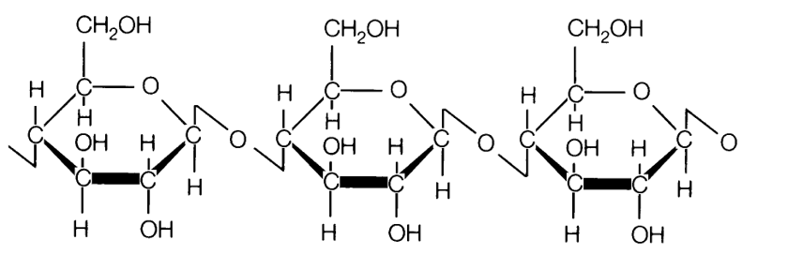
Carbohydrates
Immediate energy source, cellulose in plants
cellular support in plants, fungi, and animals.
1 carbon : 2 hydrogen : 1 oxygen
Complex (Polysaccaride: poly= many; saccaride= sugar)
Fiber (indigestible)
Starch (digestible)

Slide 10
Carbohydrates
Simple
Monosaccharide: mono=one: Glucose, fructose—not sweet;
disaccharide: di=two: sucrose, lactose– usually sweet)
Must be in monosaccaride form for use by body.
Building block of Complex Carbohydrates
Enzymes break complex to simple

Slide 11
Carbohydrates

Slide 12
Lipids
Made mostly of carbon and hydrogen that make up the fats, oils, and waxes.
Functions:
Primary function is to store energy
Highest amount of energy per gram
prevent water loss in plants – cell membrane/wall
form the honeycomb in beehives
Hormones
Triglycerides (three chains of Fatty Acids)
Saturated Fats: Usually animal sources, all single bonds
Unsaturated: Usually plant sources, at least one double bond

Slide 13
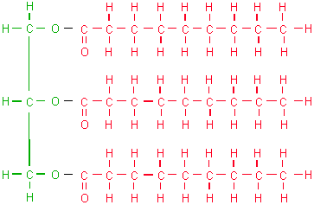
Lipids

Slide 14
Proteins
Build and repair body tissues
Enzymes needed for digestion and communication in organisms
Amino Acids building blocks
made of carbon, nitrogen, oxygen, hydrogen, and sometimes sulfur

Slide 15
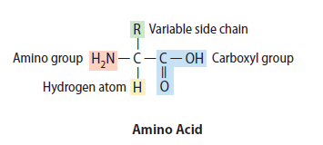
Proteins
20 different amino acids
proteins are composed of various combinations.

Slide 16
Nucleic acids
complex macromolecules
transmit and store genetic information.
composed of smaller repeating subunits
composed of carbon, nitrogen, oxygen, phosphorus, and hydrogen
called nucleotides
two types of nucleic acids in living organisms:
Deoxyribonucleic acid (DNA)
Ribonucleic acid (RNA)

Slide 17
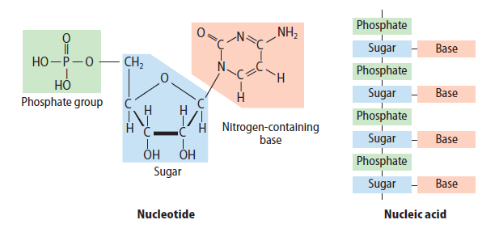
Nucleotide vs Nucleic Acid

Slide 18
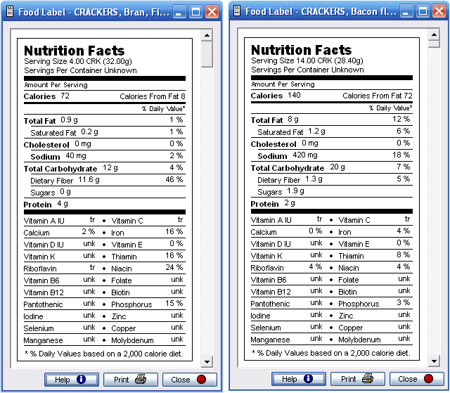
Food Labels
Fat: 1 g = about 9 Calories Carbohydrates: 1 g = about 4 Calories
Calculations:
Notice the indentation under Fat, and Carbohydrates (these are subcategories). Must CALCULATE the UNSATURATED Fat and must calculate the Starch

Slide 19
Nutrient Usage
Body uses nutrient in the order of:
Carbohydrates (simple first then breakdown complex)
Fats (ingested first before stored)
Proteins Last
Remember:
Fiber: non digestable
Sodium: Salt
Cholesterol: Found in animal cell membranes (should be zero in 100% plant products)

Slide 20
Testing for Nutrients
Protein: Biuret’s Test (Pink/Purple color change)
Starch: Iodine Test (Turns dark color)
Sugar: Benedict’s (Reddish and Green color change)
Fats: Spot Test (Dissolve in alcohol and leaves a spot on paper)

