Slide 1
Chemistry in Biology (2.1)

Slide 2
MATTER
All matter is composed of atoms!
Atoms are the building blocks of matter.

Slide 3
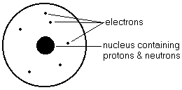
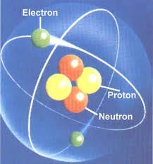
Atom

Slide 4
Parts of Atom
Nucleus – the dense center of the atom that contains the protons and neutrons
Electron cloud – area around the nucleus where the electrons exist.
An atom is mostly empty space.

Slide 5
Structure of Atoms
There are 3 basic subatomic particles.
 | electron | proton | neutron
Location | Electron cloud | nucleus | nucleus
Charge | - | + | neutral
Mass | 0.0001 amu | 1 amu | 1 amu

Slide 6
Matter that is made up of only one kind of atom is known as an element

Slide 7
Elements
Elements:
Pure substance – cannot be broken down into other substances
Composed of only one kind of atom.
Oxygen is only composed of oxygen atoms.
92 different elements occur naturally
Elements of the Periodic Table – (Video)

Slide 8
Intro to Periodic Table
Mendeleev – discoverer of the periodic law and thus the periodic table.
He arranged the periodic table looking for trends or patterns.
Has been changed over time .

Slide 9
Symbols, Formulas & Equations
Elements are the most basic level made up of all one type of atom.
Identified by chemical symbol
Organized on the Periodic Table of Elements

Slide 10
Intro to Periodic Table
Each small square on the periodic table shows:
The symbol for the element
The atomic number of the element
The atomic mass of the element

Slide 11
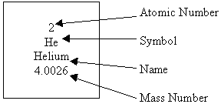
Intro to Periodic Table

Slide 12
Symbols
Rules for writing abbreviations
First letter always capital
Second letter (if present) always lower case
Some symbols derived from Latin names:
Sodium - Na - Natrium
Iron - Fe - Ferium (blacksmiths called farriers)
Lead - Pb - Plumbum (derived by a plumber)

Slide 13
Elements on the Periodic Table
Atomic Number
The number of protons in the nucleus
Unique to each element
Smaller # on periodic chart
Protons and neutrons have a mass of 1 atomic mass unit
Electrons are so small they are not counted in the mass of the atom
Number of electrons equals number of protons

Slide 14
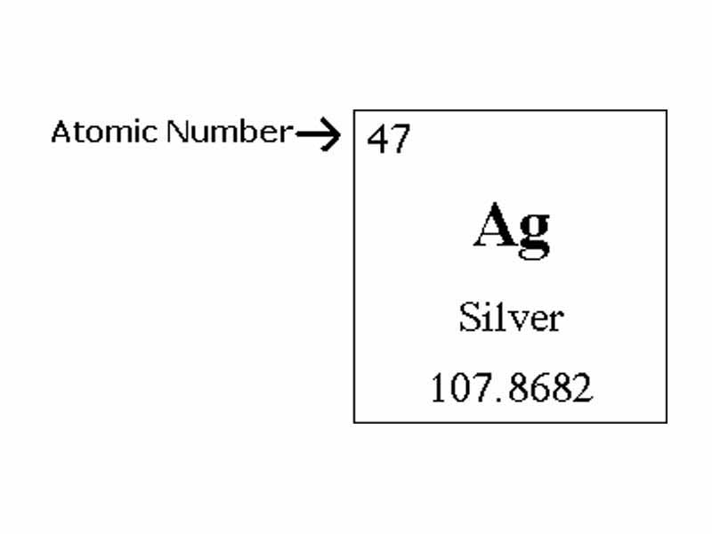
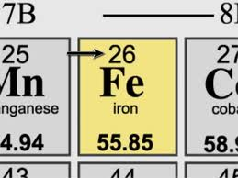
Atomic Number

Slide 15
Mass Number
Mass number
Also referred to as atomic mass
The number of protons and neutrons added together
The number of neutrons in an atom can be calculated by subtracting the # of protons (atomic #) from the mass number
mass # - atomic # = # of neutrons

Slide 16
Elemental Information
Electrons = #protons and the Atomic number
Protons = # electrons and the Atomic Number
Neutrons = Mass # - # of Protons

