Slide 1
Molecular Genetics and Biotechnology
Chapter 12

Slide 2
DNA

Slide 4
Discovery of the Genetic Material
After the rediscovery of Mendel’s work, scientist began to look for the molecule involved in inheritance.
For many years, scientists struggled to determine if DNA or protein was the source of genetic information.
Copyright © McGraw-Hill Education

Slide 5
Discovery of the Genetic Material
Miescher
1860’s
“nuclein”
Griffith
First major experiment searching for the genetic material
Involved transformation between two forms of S. pneumoni
Copyright © McGraw-Hill Education

Slide 8
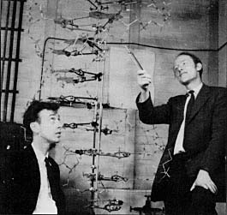
DNA Structure
James Watson (L) and Francis Crick (R), and the model they built of the structure of DNA.
Copyright © McGraw-Hill Education

Slide 9
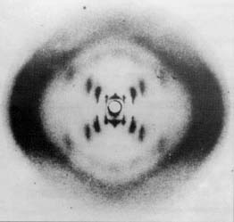
DNA Structure
Double helix
X-ray diffraction techniques indicated that DNA was a double helix, or a twisted ladder shape.
Formed by two strands of nucleotides twisted around each other.
Copyright © McGraw-Hill Education

Slide 10
Chromosome Structure
Eukaryotes
DNA in individual chromosomes
Nucleus
Prokaryotes
DNA in Cytoplasm
DNA: The Genetic Material
Copyright © McGraw-Hill Education

Slide 11
Chromosome Structure
To fit into a cell, DNA coils around a group of beadlike proteins
Group together into chromatin fibers
Supercoil to form a chromosome.
DNA: The Genetic Material
Copyright © McGraw-Hill Education

Slide 12
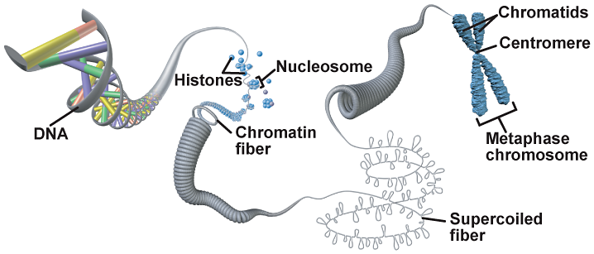

Slide 13
The structure of DNA and RNA
Genetic material of living organisms is either DNA or RNA.
DNA – Deoxyribonucleic acid
Double Strand
RNA – Ribonucleic acid
Single Strand
Genes are lengths of DNA that code for particular proteins.

Slide 15
DNA Structure
Nucleotides
Nucleotides are the subunits of nucleic acids, and consist of
5-carbon sugar
Phosphate group
Nitrogenous base

Slide 16
DNA Structure
Pentose Sugar
5 carbon sugar
DNA – deoxyribose
RNA - ribose

Slide 17
DNA Structure
Phosphate Group
Link the sugar of one nucleotide onto the phosphate of the next nucleotide to make a polynucleotide.

Slide 18
DNA Structure
Nitrogenous bases -
In DNA the four bases are:
Thymine
Adenine
Cytosine
Guanine
In RNA the four bases are:
Uracil
Adenine
Cytosine
Guanine

Slide 19
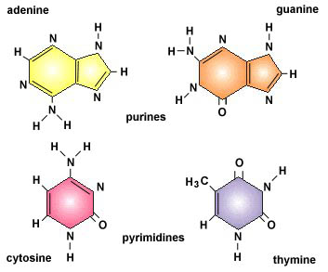
Four Nucleotide bases
Four kinds:
2 Purine bases
2 Pyrimidine bases

Slide 20
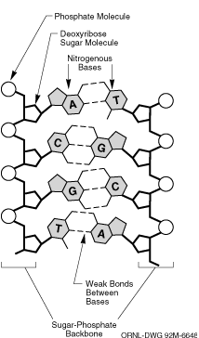
DNA: Complimentary base pairing
Adenine pairs with Thymine
A = T
Bond Type =
double
Cytosine pairs with Guanine
C = G
Bond Type =
triple

Slide 21
DNA Structure
DNA often is compared to a twisted ladder.
Rails of the ladder are represented by the alternating deoxyribose and phosphate.
The pairs of bases (cytosine-guanine or thymine-adenine) form the steps.

Slide 22
The Double Helix

Slide 25
DNA STRUCTURE VIDEO

Slide 30
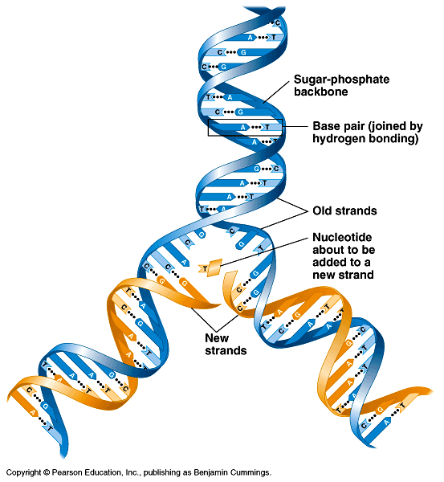
DNA Replication (in nucleus)
Matching bases allows DNA to be easily copied

Slide 31
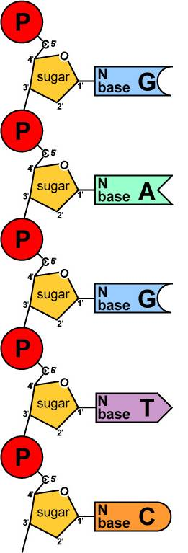
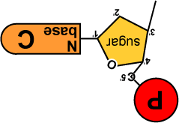
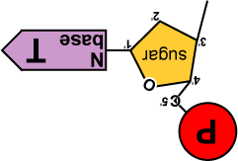
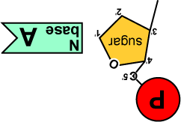
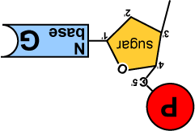
Copying DNA
Build daughter DNA strand
use original parent strand as “template”
add new matching bases
synthesis enzyme = DNA polymerase
DNA
Polymerase

Slide 32
Notes:
T A C G G T A G C
A T G C C A T C G

Slide 33
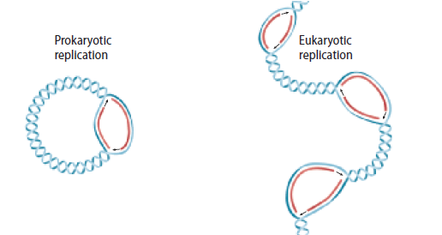
Comparing DNA Replication
Eukaryotes and Prokaryotes
Eukaryotic DNA unwinds in multiple areas as DNA is replicated.
In prokaryotes, the circular DNA strand is opened at one origin of replication.
Copyright © McGraw-Hill Education

Slide 34
Replication of DNA and Chromosomes
Speed of DNA replication: 3,000 nucleotides/min in human 30,000 nucleotides/min in E.coli
Accuracy of DNA replication: Very precise (1 error/1,000,000,000 nt)

Slide 35
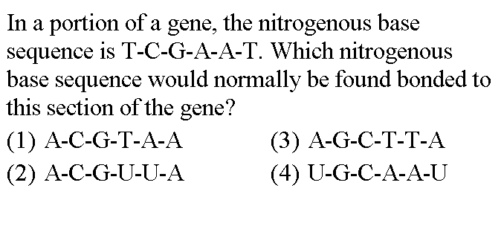
3

Slide 36
Base your answer to the following question on the diagram below which represents a portion of a double-stranded DNA molecule and on your knowledge of biology.
The base sequence of strand II is most likely:
C-A-C-T-G-G 3. G-T-G-U-C-C
G-G-T-C-A-C 4. G-T-G-A-C-C
4

Slide 37
Practice
On your paper, complete the missing DNA strand by adding the complementary bases.
A T C G T T G C C A T C
T A G C A A C G G T A G

Slide 38
YUMMY GUMMY DNA
OR
Have Your DNA and Eat It Too

