Slide 1
DNA, RNA & Protein
Chapter 12: Section 3

Slide 2
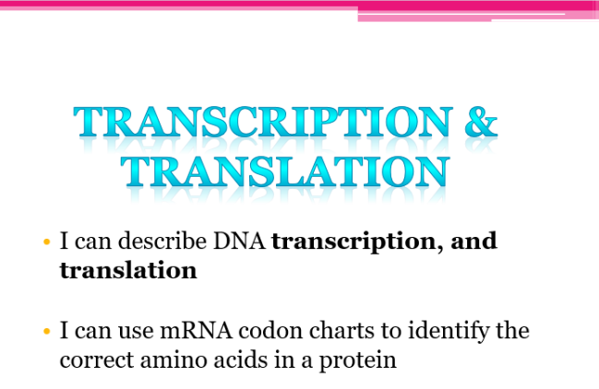

Slide 3
Central Dogma
Investigate how DNA served as a genetic code for the synthesis of proteins.
Geneticists accept that the basic mechanism for reading and expressing genes is from DNA to RNA to protein.
This is referred to as the central dogma of biology:
  DNA codes for RNA, which guides the synthesis of proteins.
Copyright © McGraw-Hill Education

Slide 4
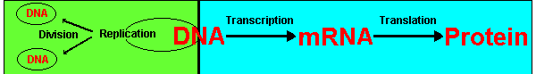

Slide 5
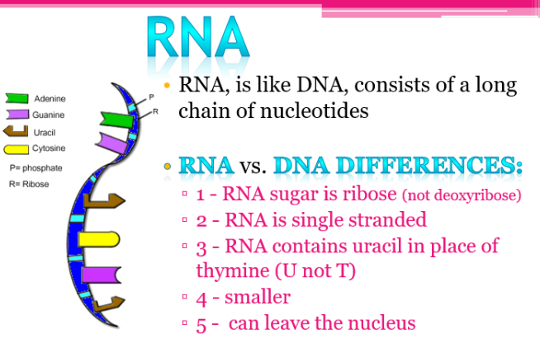

Slide 6
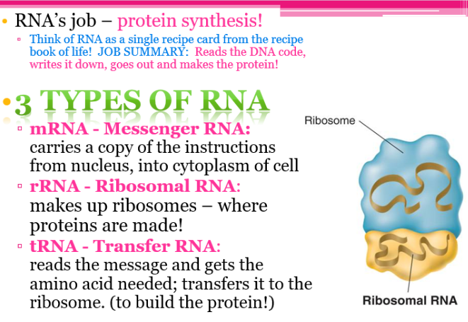
Copyright © McGraw-Hill Education

Slide 7
Transcription & Translation
Bozeman Science
Transcription & Translation Video

Slide 8
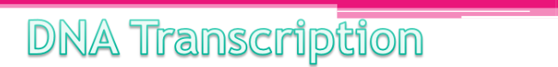
Part of DNA molecule is copied to make mRNA molecules (using complimentary base pairing.
THINK: The sequence of nucleotides in a mRNA is determined by the sequence in the
?
DNA

Slide 9
Central Dogma
Transcription
First step synthesis of mRNA from DNA in a process called transcription.
RNA polymerase moves along the DNA strand in a 3’ to 5’ direction, synthesizing mRNA.
Copyright © McGraw-Hill Education

Slide 10
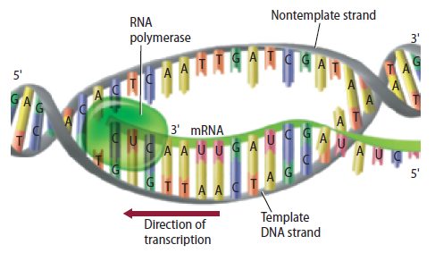

Slide 11
Practice
Make the complementary RNA strand for the single strand of DNA below:
A A T C A T C A C G T T
U U A G U A G U G C A A
Make the complementary RNA strand for the single strand of DNA below:
T A C C C G A G G T A G C C G C G T A T T
A U G G G C U C C A U C G G C G C A U A A

Slide 12
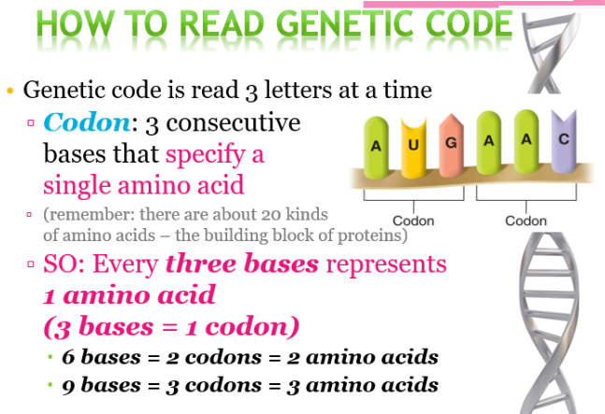

Slide 13
Reading the genetic code
The genetic code is responsible for building all the proteins in the body using 20 different amino acids.
How many 3 letter words can you make from the letters A,T,G and C?
Answer: 64

Slide 14
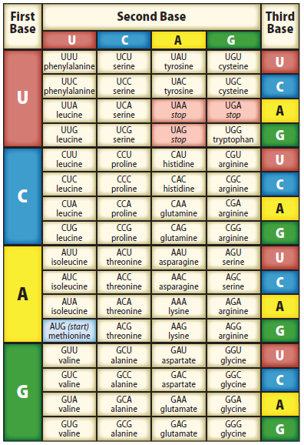
The Code
Scientists hypothesized that the instructions from protein synthesis were encoded in DNA.
Experiments during the 1960s demonstrated that the DNA code was a three-base code.
The three-base code in DNA or mRNA is called a codon.
DNA, RNA, and Protein
Copyright © McGraw-Hill Education

Slide 15
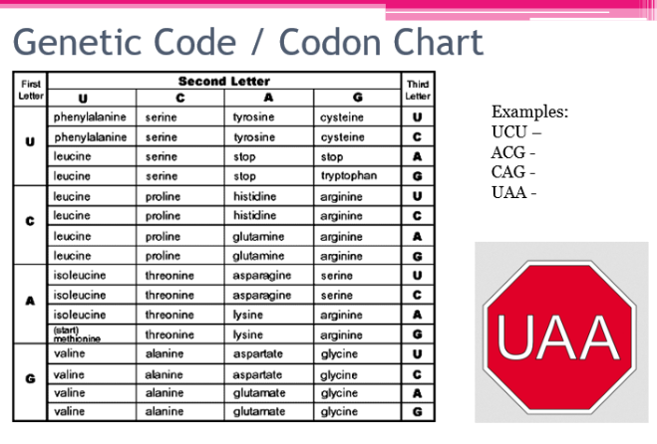

Slide 16
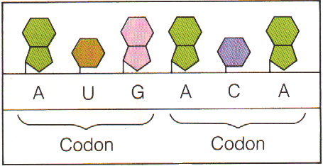
Codons
A three letter “word” that specifies an amino acid.

Slide 17
A. Messenger RNA (mRNA)
start
codon
A
U
G
G
G
C
U
C
C
A
U
C
G
G
C
G
C
A
U
A
A
mRNA
codon 1
codon 2
codon 3
codon 4
codon 5
codon 6
codon 7
protein
methionine
glycine
serine
isoleucine
glycine
alanine
stop
codon

Slide 18
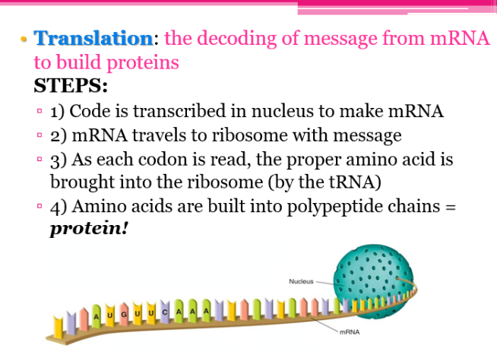

Slide 19
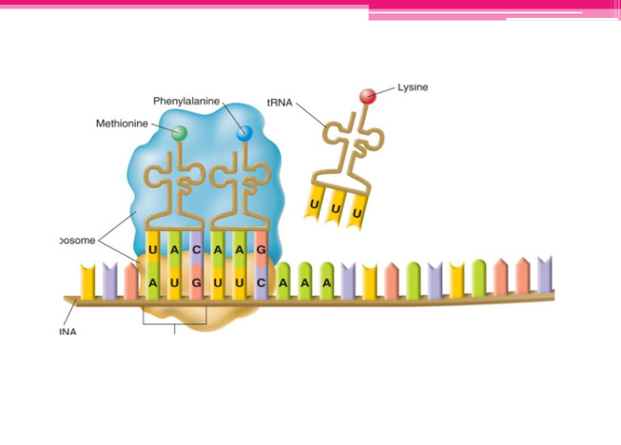

Slide 20
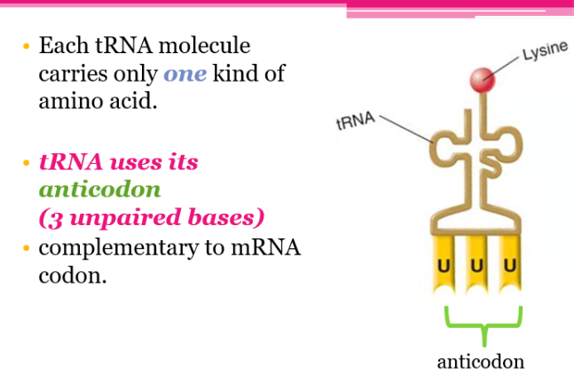

Slide 21
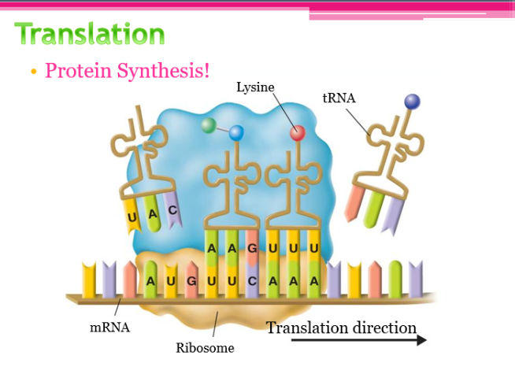

Slide 22
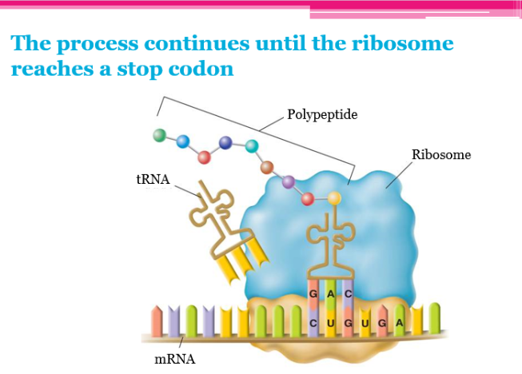

Slide 23
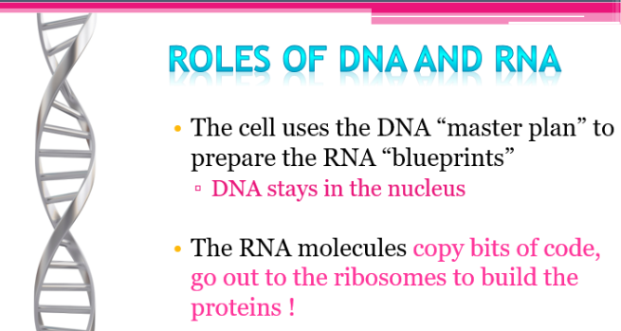
DNA and RNA
by the Amoeba Sisters

Slide 24
If the cell is a school…
The Nucleus is the school office
The Nucleolus is the principal’s office
The DNA is the principal
Ribosomes are the cafeteria ladies
mRNA is the email from the principal to the cafeteria lady

Slide 25
From DNA to Protein
http://www.hhmi.org/biointeractive/translation-basic-detail#video-7b9676a4-5f24-4837-9aaf-9352eed43c1e

Slide 26
Review/Explain:
Types of Nucleic Acids
What are the two types of nucleic acids?
Ribonucleic Acid (RNA)
Single Stranded
Deoxyribonucleic Acid (DNA)
Double Helix
  (Twisted Ladder)

Slide 27
Questions
Name one difference between DNA and RNA.
  DNA – Double Helix, RNA – Single Stranded
  DNA --- A-T, RNA ---A-U
  DNA ---Deoxyribose Sugar, RNA---Ribose
What is a similarity of DNA and RNA?
  G binds with C in both DNA and RNA
  Both have sugar and phosphate backbone

Slide 28
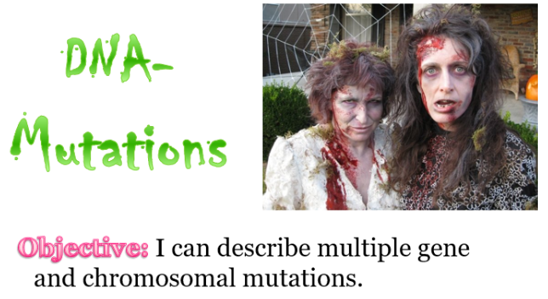
Video Intro

Slide 29
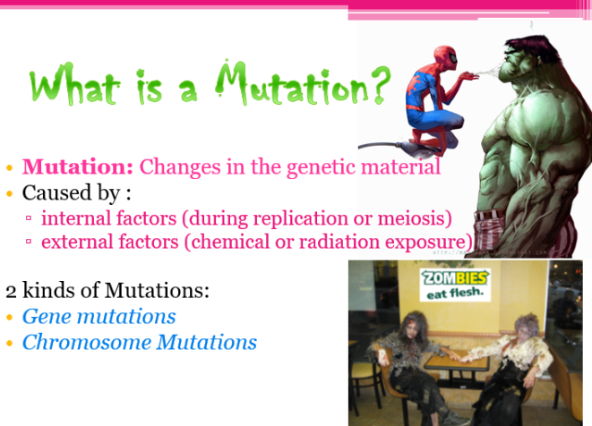

Slide 30
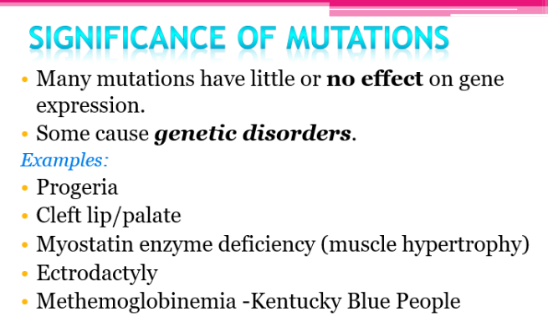

Slide 31
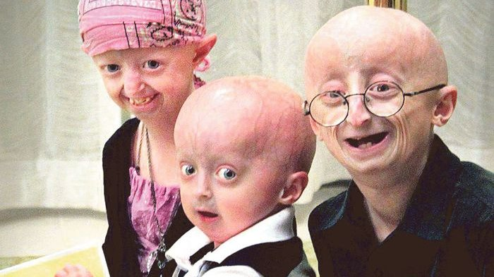
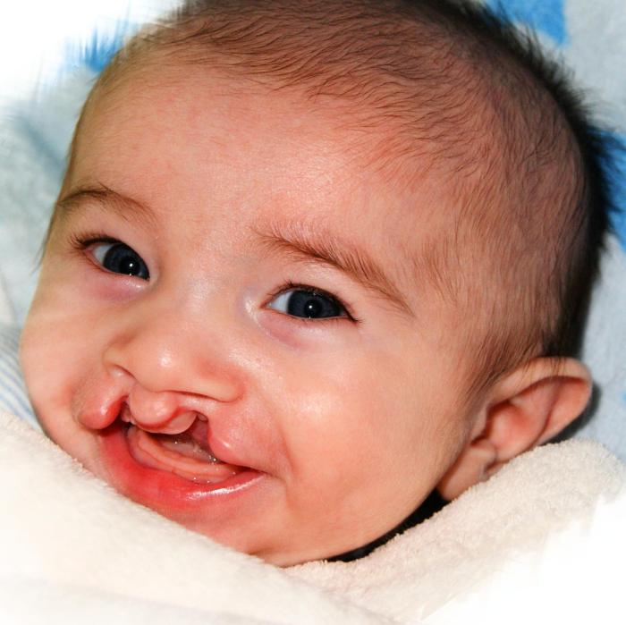
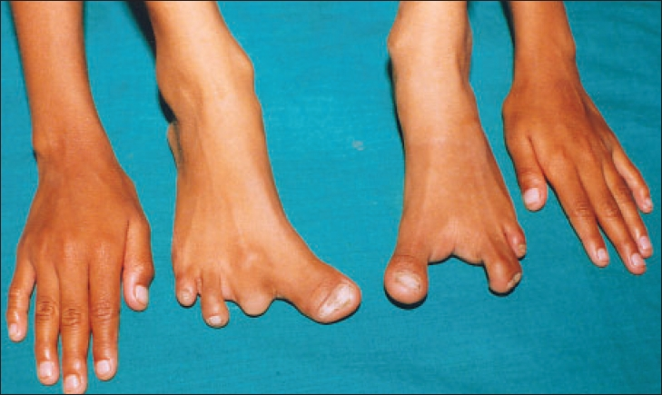
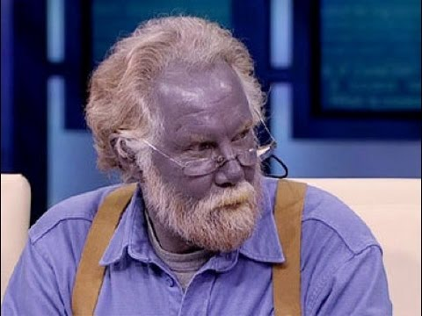

Slide 32
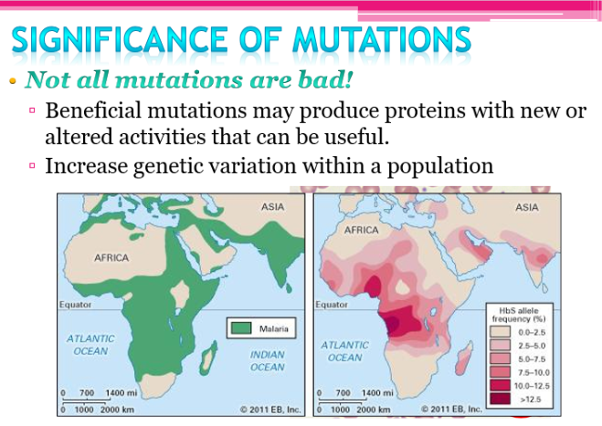

Slide 33
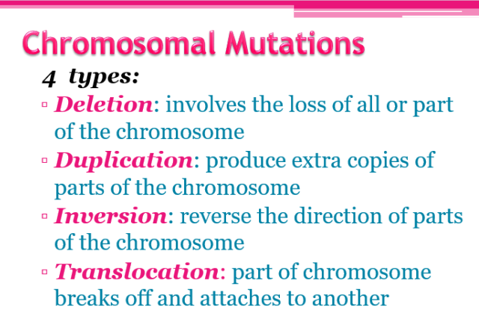

Slide 34
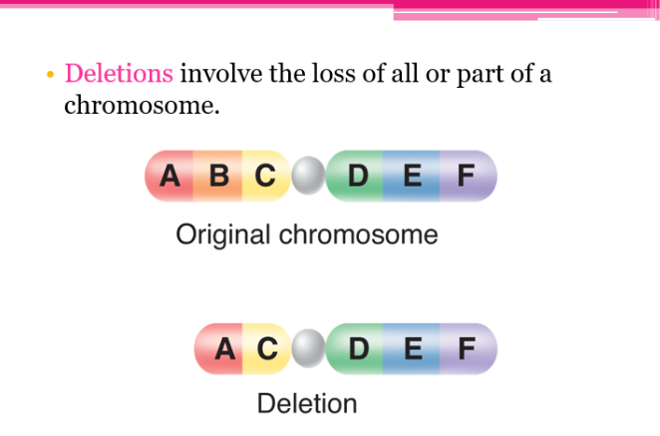

Slide 35
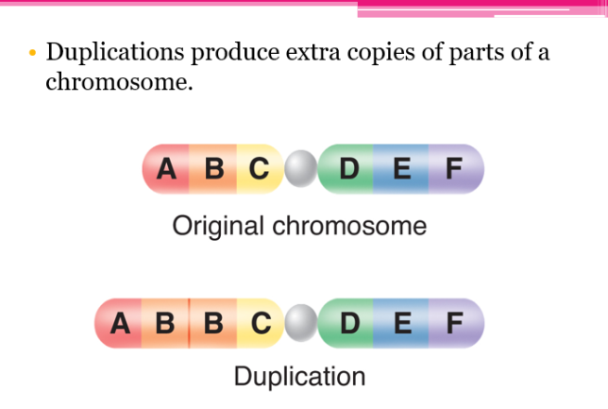

Slide 36
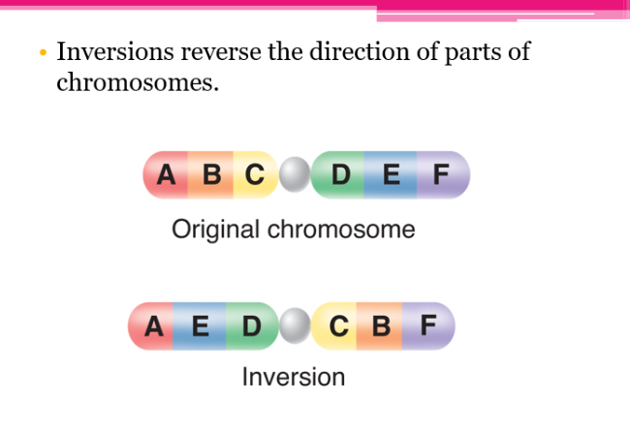

Slide 37
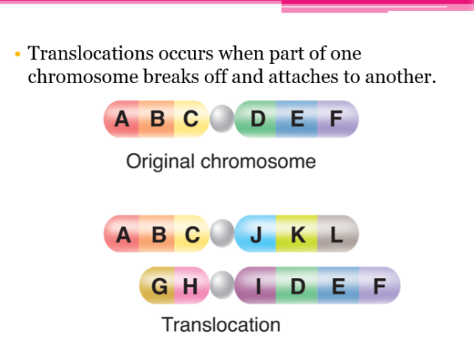

Slide 38
Mutations:
The power of small change
REVIEW

Slide 39
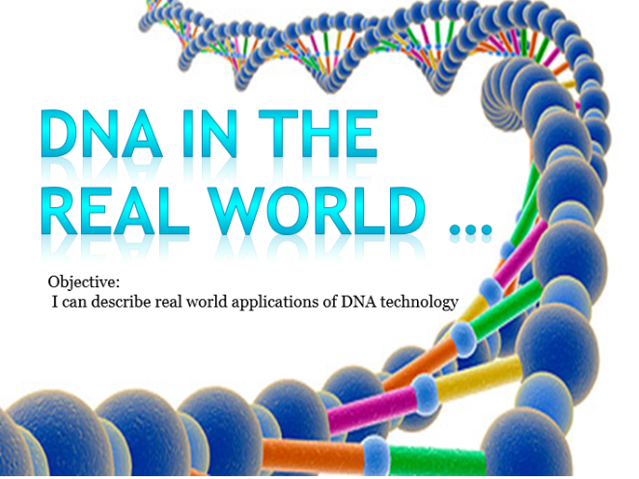

Slide 40
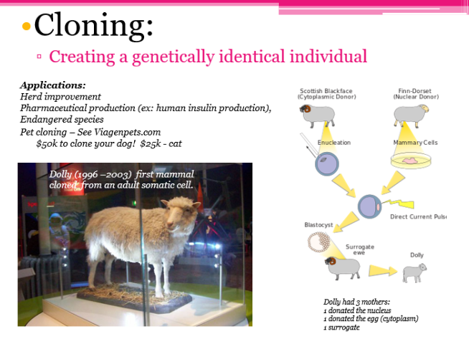

Slide 41
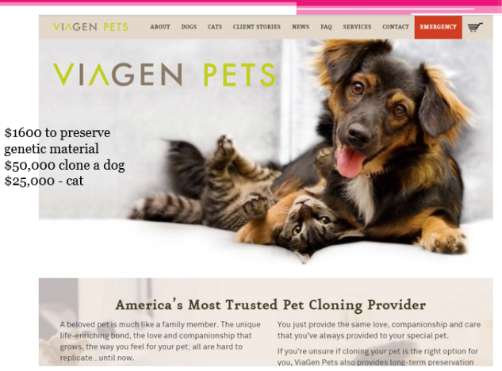

Slide 42
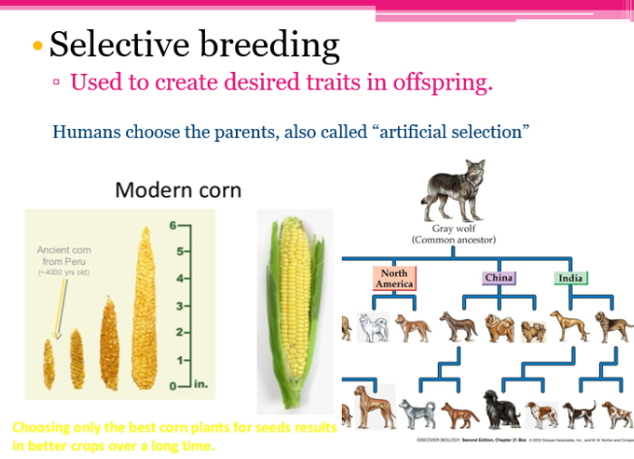

Slide 43
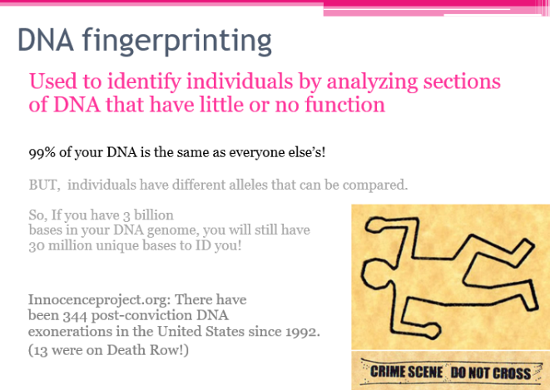

Slide 44
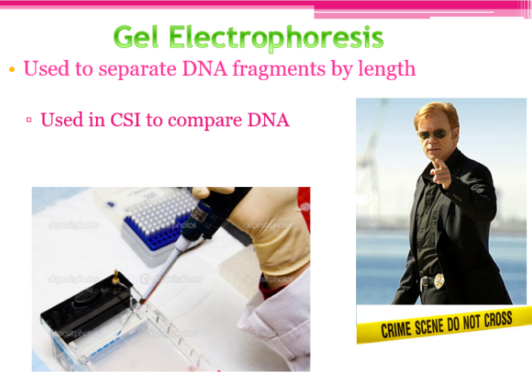

Slide 45
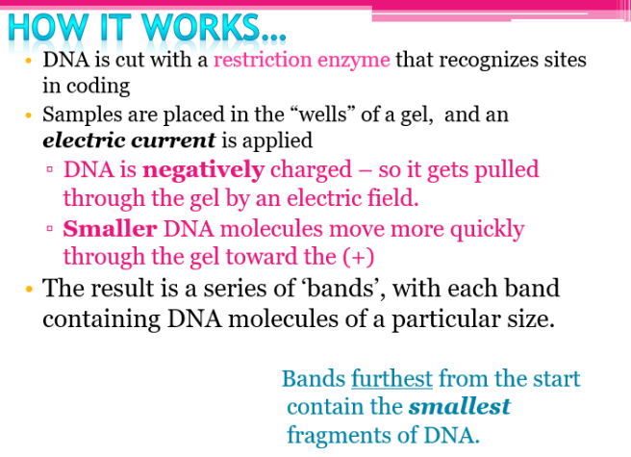

Slide 46
Gel Electrophoresis
use to separate DNA
fragments
determine
relationships
used in forensics

Slide 47
Study the diagram on
the left side of this
slide.
Which of the following
DNA samples of
individuals are most
closely related?
EXPLAIN.
DNA sample 1 & 7

Slide 48
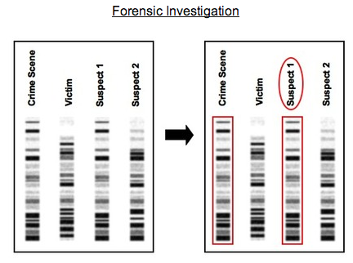
Crime Scene #1

Slide 49
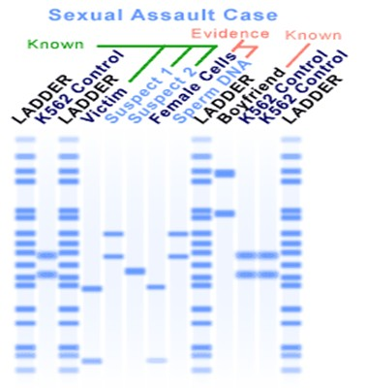
Crime Scene
#2

Slide 50
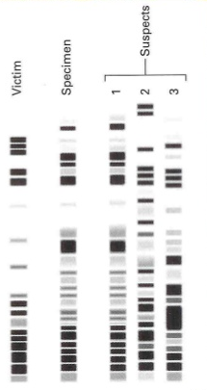
Crime Scene
#3

Slide 51
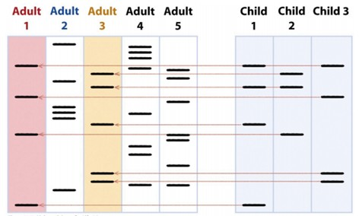
Paternity

Slide 52
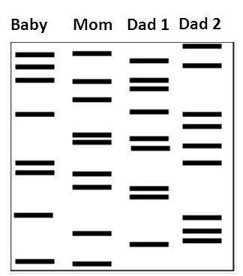
Paternity
#1
Dad 2

Slide 53
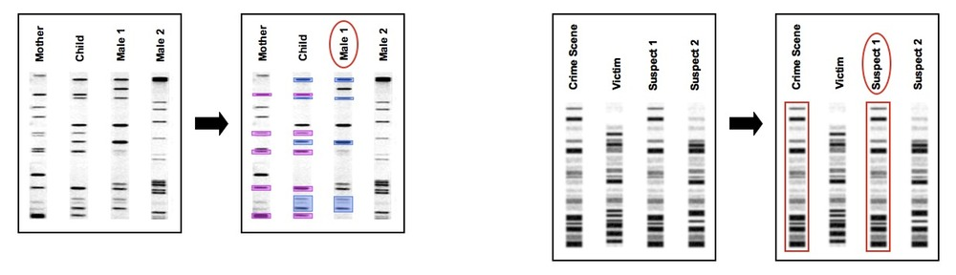
Paternity #2

Slide 54
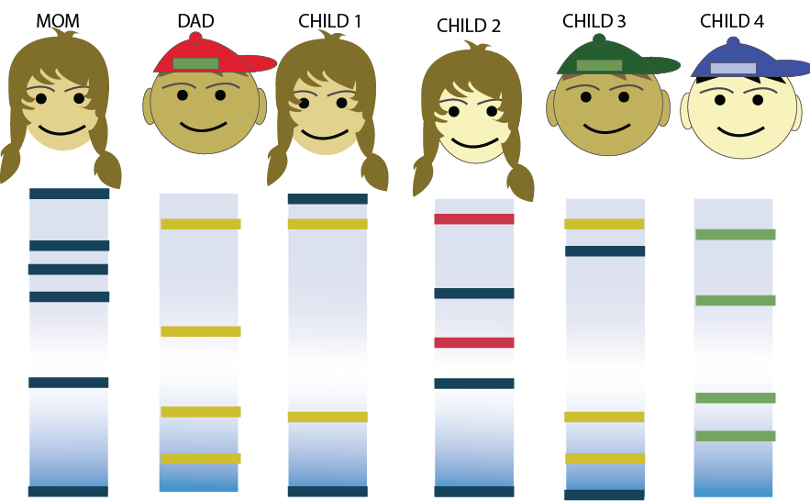
WHO ARE THE PARENTS?

Slide 55
WHO ARE THE PARENTS?
Child 1
Child 2
Child 3
Child 4
Mom and Dad
Mom
Mom and Dad
Neither

